Slide 1
Scheduling Algorithms for Multiprogramming in a Hard-Real-Time Environment
Authors：C. L. LIU JAMES W. LAYLAND
Presenters： Lanzheng Cao，Yitong Zhang，Haiyang Liu

Slide 2

1 Background

Slide 3
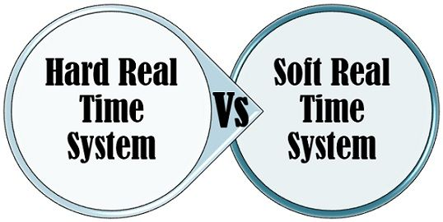
1.1 Hard-real-time Environments
Basis for Comparison | Hard real time system | Soft real time system
Basic | Employs extreme stringent requirements. | Less restrictive
Outcome of the deadline miss | Disastrous if system fails. | The system failure does not result in severe harm.
Usefulness | Reduces abruptly with the increase in tardiness. | Decreases gradually as tardiness increases.
Failure to hit the deadline | Does never occur in hard real-time system (Deterministic). | At times (Probabilistic).
Timing constraints | Hard when user requires validation. | Soft if there is no requirement of validation.
Quality of service provided | Temporal | Best
In "hard-real-time" environments, tasks must be completed within a fixed deadline; failure to do so is unacceptable!

Slide 4
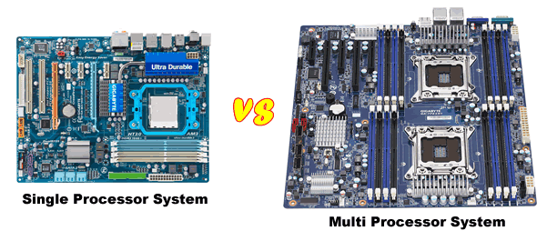
1.2 Limitations of Existing Solutions
Most literature on multiprogramming focuses on commercial time-sharing or the scheduling of batch-processing facilities, often in multi-processor systems.
Some research exists on hard-real-time scheduling, but it often has unrealistic assumptions or lack specific algorithms.

Slide 5
2 Fixed Priority Scheduling Algorithm

Slide 6
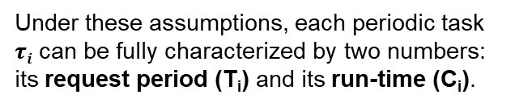
2.1 Environments
5 Assumptions:
(A1) Periodic Requests
(A2) Run-ability Constraints
(A3) Task Independence
(A4) Constant Run-time
(A5) Special Non-Periodic Tasks
Under these assumptions, each periodic task $τi$ can be fully characterized by two numbers: its request period (T_{i​}) and its run-time (C_{i​}).

Slide 7
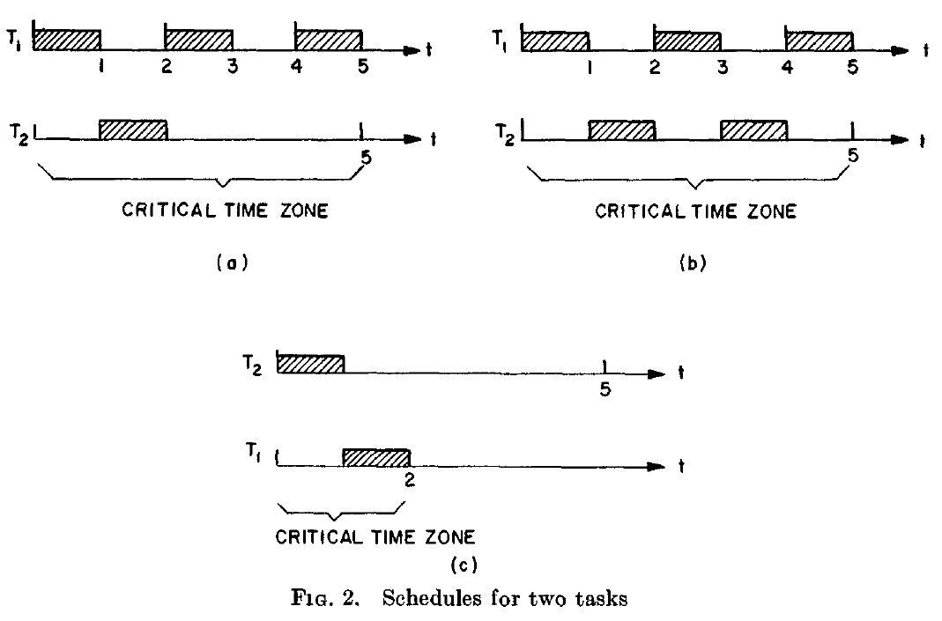
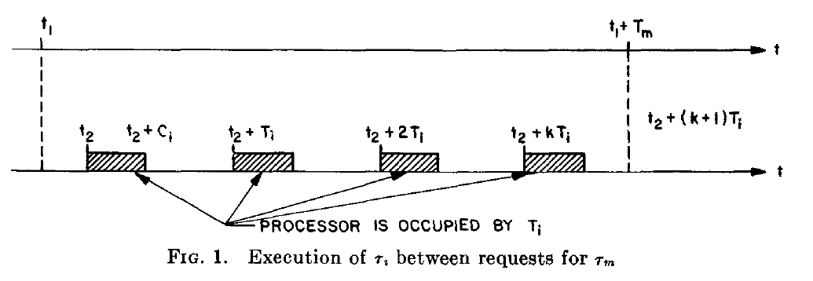
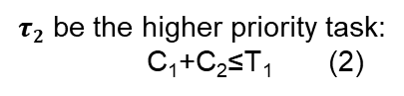
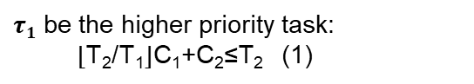
2.2 Theorem 1
THEOREM 1. A critical instant for any task occurs whenever the task is requested simultaneously with requests for all higher priority tasks.
T₁<T₂
$τ1$ be the higher priority task:
⌊T₂​/T​₁⌋C_{1​}+C₂​≤T₂ (1)
(2) implies (1)
​$τ2$ be the higher priority task:
C₁​+C₂​≤T₁ (2)
rate-monotonic priority assignment

Slide 8
2.3 Theorem 2
any feasible priority assignment can be transformed into a rate-monotonic one
How?
adjacent priority swaps, with each swap preserving feasibility
THEOREM 2. If a feasible priority assignment exists for some task set, the rate monotonic priority assignment is feasible for that task set.

Slide 9
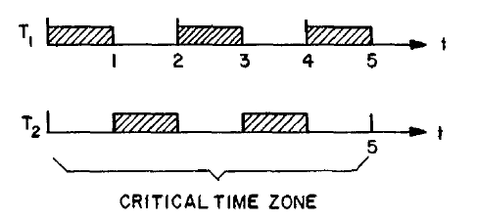
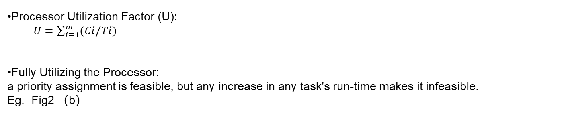
2.4 Achievable Processor Utilization
Processor Utilization Factor (U):
$U=\sum_{i=1}^{m}{(Ci/Ti)}$
Fully Utilizing the Processor:
a priority assignment is feasible, but any increase in any task's run-time makes it infeasible.
Eg. Fig2 （b）
T1 = 2, T₂ = 5
C₁ = 1, C₂ = 1
(Fully Utilized)
The Least Upper Bound:
The minimum utilization factor over all task sets that fully utilize the processor.

Slide 10
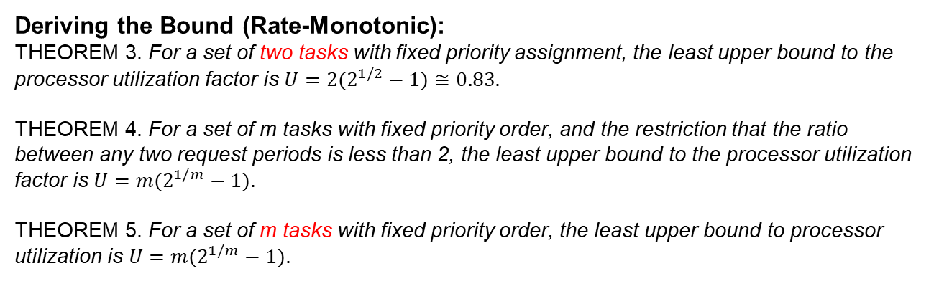
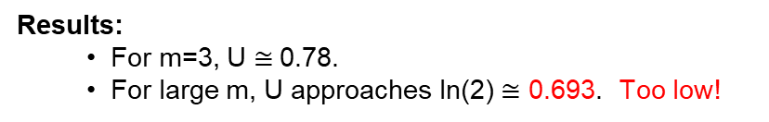
2.4 Achievable Processor Utilization
Deriving the Bound (Rate-Monotonic):
THEOREM 3. For a set of two tasks with fixed priority assignment, the least upper bound to the processor utilization factor is $U=2(2^{1/2}−1)$ $≅0.83$.
THEOREM 4. For a set of m tasks with fixed priority order, and the restriction that the ratio between any two request periods is less than 2, the least upper bound to the processor utilization factor is $U=m(2^{1/m}−1)$.
THEOREM 5. For a set of m tasks with fixed priority order, the least upper bound to processor utilization is $U=m(2^{1/m}−1)$.
Results:
For m=3, U $≅$0.78.
For large m, U approaches ln(2) $≅$ 0.693. Too low!

Slide 11
3 Deadline Driven Scheduling Algorithm

Slide 12
3.1 Introduction
Characteristics of the Deadline-Driven Scheduling Algorithm
Dynamic Priority Assignment
Each task’s priority is determined by the deadline of its current request. The closer the deadline, the higher the priority.
Earliest Deadline First Strategy
At any moment, the scheduler selects the task with the earliest pending deadline to execute.
Preemptive Scheduling
If a newly arrived task has a nearer deadline than the currently running task, it will preempt and take over the processor.

Slide 13
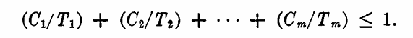
3.2 Support
No Idle Time Before Overflow
Feasibility Condition: Utilization ≤ 100%
(Theorem 6) If an overflow occurs, the processor must have been fully utilized up to that point—no idle time is wasted.
This means EDF never “slacks off.”
Every available processor cycle is used to serve the most urgent tasks.
(Theorem 7) EDF scheduling is feasible if and only if the total processor utilization satisfies:
A simple, powerful rule: If the total demand does not exceed the processor’s capacity, EDF guarantees success.
Conclusion
These two principles demonstrate that EDF is not only logically sound but also globally optimal among all scheduling algorithms for hard real-time systems.

Slide 14
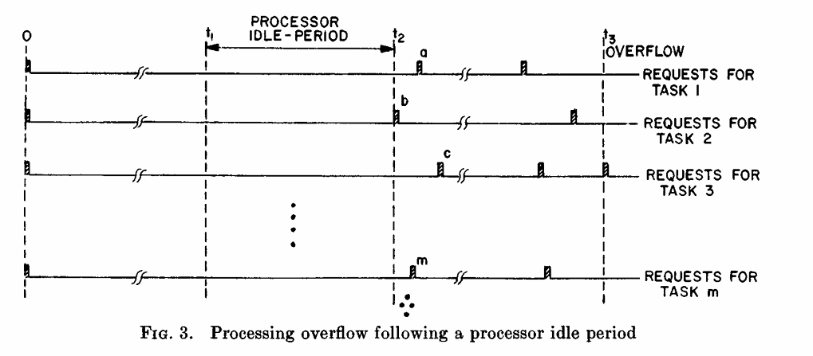
3.3 Provement
THEOREM 6
Full Utilization Before Overflow
Between time 𝑡2 and 𝑡3, the processor is fully utilized. Overflow occurs at 𝑡3.
Rescheduling Argument
If any task requests (e.g., a, b, c) are shifted earlier to 𝑡2, the processor remains fully occupied.
No idle time is created, and overflow may even occur earlier due to tighter scheduling.
Contradiction via Rescheduling
If idle time were possible before overflow, rescheduling should allow idle time between 𝑡2 and 𝑡3. But since this is impossible, the assumption of idle time leads to contradiction.

Slide 15
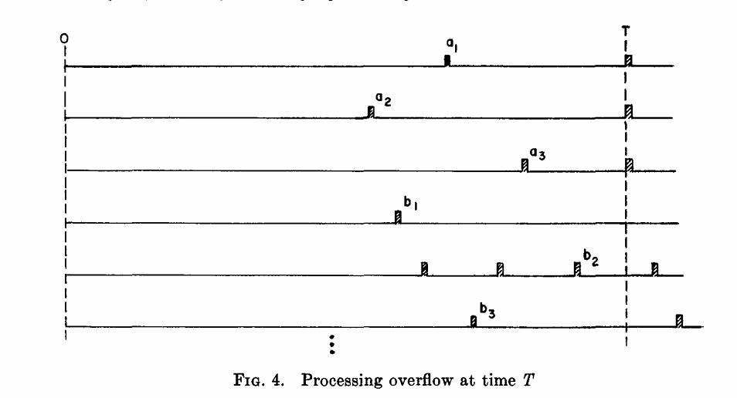
3.3 Provement
To prove Theorem 7 by contradiction:
THEOREM 7
EDF scheduling must be feasible.
Case 1: None of the b-tasks are executed before T
All requests with deadlines ≤ T are executed
Total required computation time
If total required time > T, then
Case 1 disproves the possibility of overflow under the utilization condition. Next slide: Case 2 – Partial execution of b-tasks.
a: Task requests with deadlines ≤ T
b: Task requests with deadlines > T
All a tasks are executed before T
All b tasks are pending at time T
“⌊T / Tᵢ⌋ represents the floor of T divided by Tᵢ, i.e., the number of complete task periods within time T.”

Slide 16
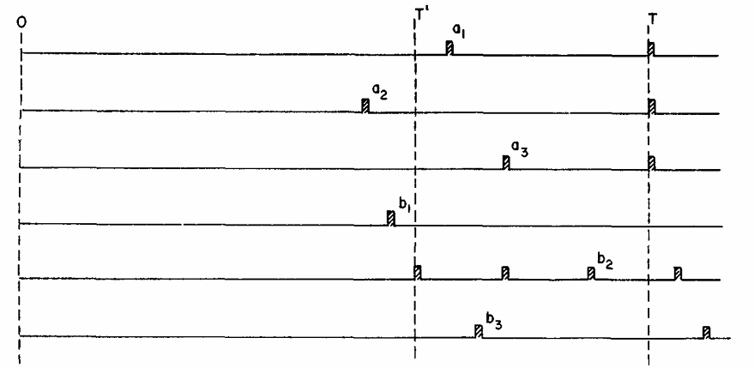
3.3 Provement
THEOREM 7
Case 2: Some of the b-tasks are executed before T
Since b-requests were executed before T′, all earlier a-requests must have earlier deadlines and were already completed
Therefore, the only remaining workload between T′ and T is from newly arrived a-requests
Total required processor time in interval [𝑇′,𝑇] is:
That an overflow occurs at T means that
Contradicts the assumption of feasibility → Theorem 7 is proven
Overflow occurs at time T
Let T′ < T be the last time any b-requests (deadlines > T) were executed
Between T′ and T, only a-requests (with deadlines ≤ T) are executed

Slide 17
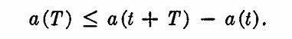
3.4 Mixed Scheduling
Mixed Scheduling Algorithm
A mixed scheduling algorithm combines two strategies:
High-frequency tasks (short periods) are scheduled using a fixed priority algorithm → typically Rate-Monotonic, compatible with hardware interrupt systems
Low-frequency tasks (longer periods) are scheduled using a dynamic priority algorithm → typically Deadline-Driven (EDF), implemented in software
The proof structure is similar to that of EDF scheduling, except that the fixed time interval 𝑇 is extended to a sublinear availability function 𝑎𝑘(𝑡).
ak (t) denote the availability function of the processor for tasks k ~ 1, k W 2, •. • , m.

Slide 18
4 From Theory to Practice

Slide 19
Three Scheduling Approaches
Fixed Priority Scheduling (RMS): simple, predictable
Dynamic Priority Scheduling (EDF): flexible, high utilization
Mixed Scheduling Approaches: balance RMS and EDF
“Which approach do companies actually choose?”
In practice, the choice depends not only on utilization, but also on predictability, implementation cost, and certification requirements.

Slide 20
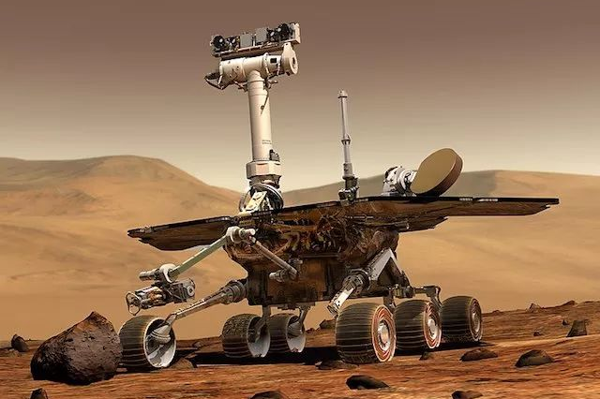

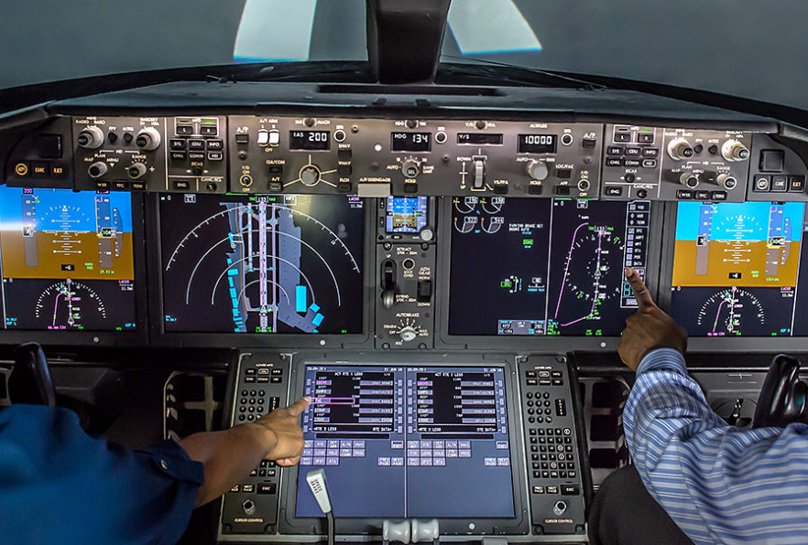
4.1 RMS in Practice
1）Aerospace：VxWorks from Wind River
A real-time operating system
DO-178C: strict safety standard
DO-178C: Software Considerations in Airborne Systems and Equipment Certification
Wind River Systems. (2023). VxWorks datasheet: The industry’s leading real-time operating system (RTOS). Wind River. Retrieved from https://www.windriver.com/resource/vxworks-datasheet
NASA Mars rovers
Boeing avionics

Slide 21

4.1 RMS in Practice
2）Automotive Industry：AUTOSAR OS
Inside the classic AUTOSAR platform
ISO26262: the automotive safety standard
AUTOSAR. (2022). Specification of Operating System (AUTOSAR_SWS_OS), Release 22-11. AUTOSAR Consortium. Retrieved from https://www.autosar.org/fileadmin/standards/R22-11/CP/AUTOSAR_SWS_OS.pdf

Slide 22

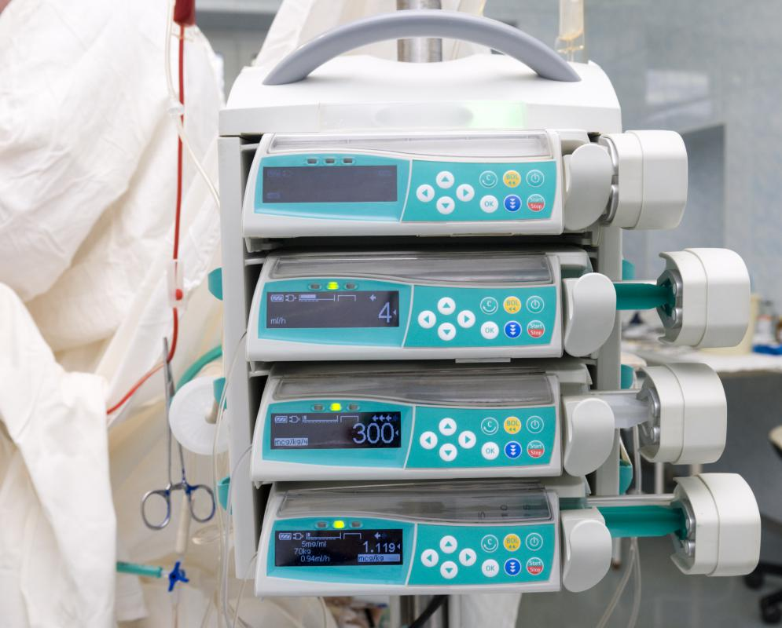

4.1 RMS in Practice
3）Medical Devices
Pacemakers
Infusion pumps
Pajic, M., Mangharam, R., Sokolsky, O., Arney, D., Goldman, J. M., & Lee, I. (2012). Model-driven safety analysis of closed-loop medical systems. IEEE Transactions on Industrial Informatics, 8(2), 437–449. https://doi.org/10.1109/TII.2012.2198668

Slide 23




4.2 EDF in Practice
1）Mobile OS (Linux/Android)
SCHED_DEADLINE: EDF-based scheduler in Linux kernel
Handles changing workload
Linux Kernel. (2024). Deadline Task Scheduling (sched_deadline). Retrieved from https://docs.kernel.org/scheduler/sched-deadline.html

Slide 24


4.2 EDF in Practice
2）Cloud and datacenters
Google Borg: Google’s cluster manager
Kubernetes
Madden, M. M. (2019). Challenges Using Linux as a Real-Time Operating System (NASA Technical Report No. 20200002390). NASA. Retrieved from https://ntrs.nasa.gov/api/citations/20200002390/downloads/20200002390.pdf

Slide 25


4.2 EDF in Practice
3）Multimedia Streaming
Soft real-time: deadlines for video frames & audio packets
Netflix (video) & Spotify(audio)
Adapts to changing load, keeps stream smooth, drops less important work first

Slide 26



4.2 EDF in Practice
4）Telecom (5G)
5G base stations (Nokia, Ericsson, Huawei)
schedule radio packets with microsecond deadlines
Hadar, I., Leshem, G., & Leshem, A. (2019). Scheduling for 5G Cellular Networks with Priority and Deadline Constraints. Bar-Ilan University. Retrieved from https://www.eng.biu.ac.il/leshema/files/2019/01/Scheduling-For-5G-Cellular-Networks-With-PriorityAnd-Deadline-Constraints.pdf

Slide 27


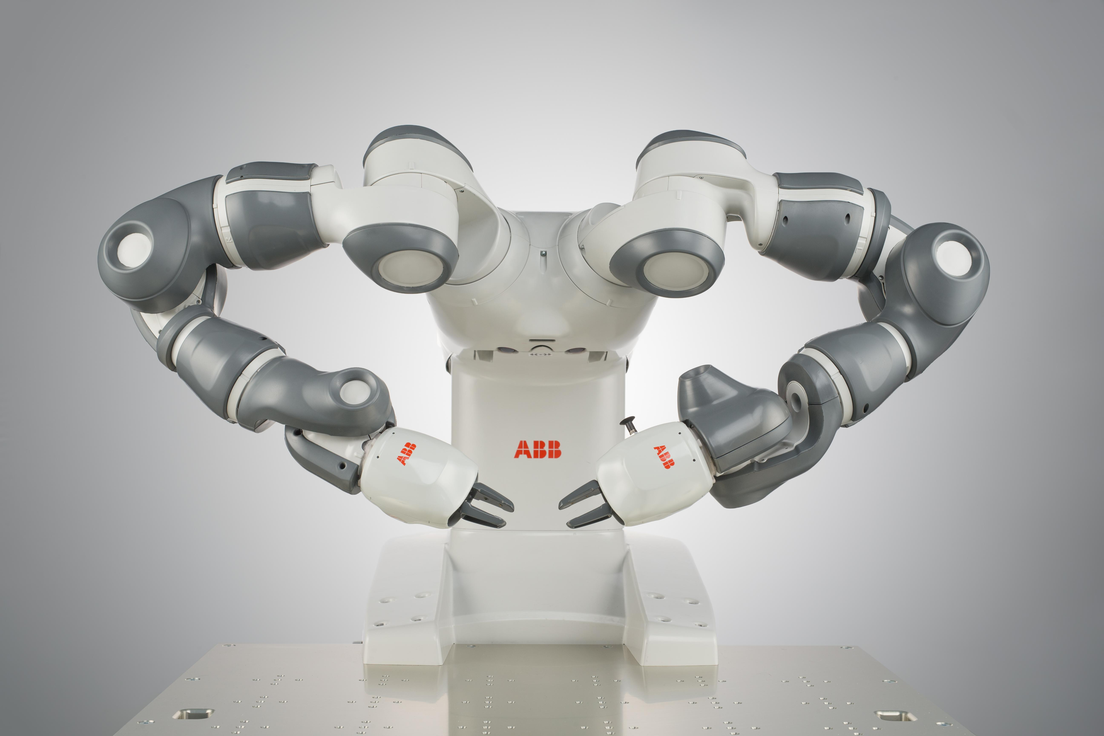
4.3 Mixed Appoaches in Practice
Where it’s used
Automotive systems
Airbus, SpaceX avionics
Siemens PLC, ABB robotics
…
Why Mixed？
✅ Balance safety & efficiency
✅ Certification prefers fixed priority, but EDF boosts utilization
✅ Used where different criticality levels coexist

Slide 28
4.4 Extension of Liu & Layland’s Work
From Theory to Modern Systems
Liu & Layland’s 1973 work laid the foundation for real-time scheduling theory
Key Extensions
Multiprocessor / Multicore Scheduling
Energy-Aware Scheduling
Cloud & AI Workloads
…

Slide 29
Thanks for Listening
Presenters： Lanzheng Cao，Yitong Zhang，Haiyang Liu

